Slide 1
CSA1470 – Compiler design for STD
CAPSTONE PROJECT ON
Compiler Design in the Era of Machine Learning and AI
PRESENTED BY :
M.SHARMILA(192210466)
K.GNAPIKA(192224254)
K.PRIYANKA(192210196)

Slide 2
COMPILER DESIGN IN THE ERA OF MACHINE LEARNING AND AI

Slide 3
ABSTRACT:
In the domain of compiler design, lexical analysis serves as a fundamental stage, where the input source code is tokenized iIn the era of machine learning and AI, compiler design has evolved to leverage advanced algorithms and data-driven techniques to optimize code generation and execution. Modern compilers are increasingly incorporating AI-driven methods to enhance performance, detect and correct errors, and adapt to diverse hardware architectures. This integration of machine learning models allows for more sophisticated optimization strategies, such as predictive modeling for resource management, automated parallelization, and adaptive compilation. nto meaningful units for subsequent parsing. Regular

Slide 4
INTRODUCTION:
What a compiler?
"A compiler translates source code written in one programming language into another language, typically machine code, for execution by a computer.“
The traditional stages of compilation:
Lexical Analysis , Syntax Analysis , Semantic Analysis , Intermediate Code Generation , Code Optimization , Code Generation
AI and machine learning are revolutionizing compiler design:
Lexical Analysis: Using ML models for tokenization and pattern recognition.
Syntax and Semantic Analysis:*AI-driven parsers and semantic validators.
Code Optimization: ML techniques for advanced optimizations like loop unrolling and register allocation.
Code Generation:*Target-specific optimizations and efficient assembly code generation.

Slide 5
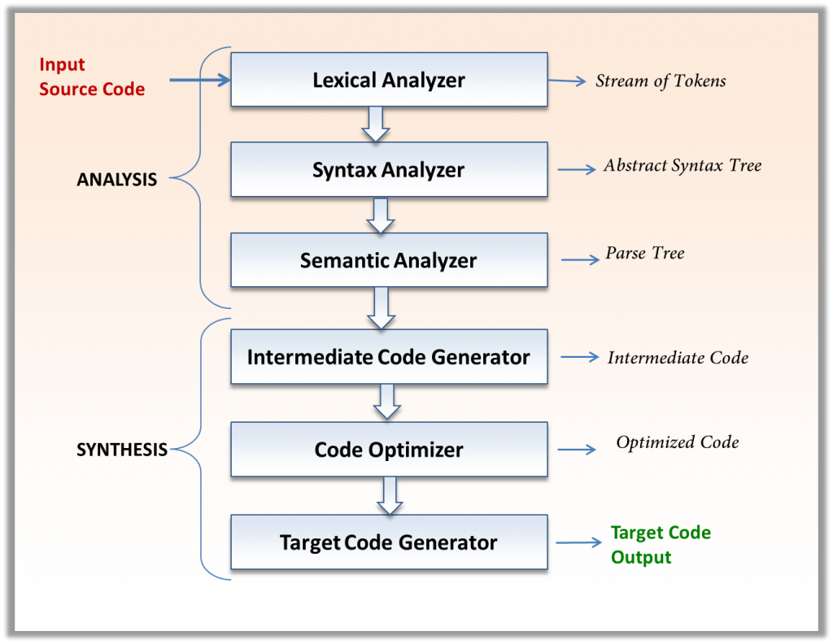

Slide 6
PROBLEM STATEMENT:
Address the challenges, such as the need for large datasets for training AI models and ensuring the reliability of AI-generated code.
Discuss future trends like AI-driven adaptive optimization, automated parallelization, and integration with development environments.
In the era of machine learning and AI, compiler design faces the critical challenge of optimizing code generation and execution for diverse and highly parallel hardware architectures, such as GPUs and TPUs, while integrating advanced AI-driven optimizations. This involves developing intelligent compilers that can leverage machine learning models to predict and optimize runtime performance, automate parallelization, and adapt to the dynamic nature of AI workloads.

Slide 7
Methodology Used for Validation and Evaluation:
- Gather a comprehensive set of source code snippets from various programming languages, representing different constructs, language features, and coding styles. This ensures robust coverage of lexical analysis scenarios.
- Utilize machine learning models to automatically classify and tag code snippets based on features like complexity, style, and construct types.
- Implement a tokenization process leveraging predefined regular expressions to parse each source code snippet and tokenize it into individual tokens.
-

Slide 8
Methodology Used for Validation and Evaluation:
-Integrate machine learning models trained on annotated code datasets to enhance the accuracy and efficiency of tokenization. These models can learn to recognize complex patterns and contexts that traditional regular expressions may miss.
- Use machine learning models to continuously improve the evaluation algorithm. These models can identify misclassifications and adjust the tokenization rules dynamically based on feedback and new data.
- Define performance metrics to assess the efficiency and effectiveness of the lexical analysis process, including tokenization speed, memory usage, and tokenization accuracy.

Slide 9
Results of Validation and Evaluation:
Benefits and Impact of AI/ML in Compiler Design:
Improved performance and efficiency of compiled code.
Automatic bug detection and correction.
Adaptability to new architectures and languages.
Enhanced developer productivity and faster iteration cycles.
Real-world applications where AI-enhanced compilers have made significant impacts (e.g., optimizing neural network inference, accelerating scientific computing, etc.).

Slide 10
Conclusion
The validation and evaluation of compiler design in the era of machine learning and AI have demonstrated significant improvements in optimization, error detection, performance prediction , security and it more efficient, adaptive, and capable of handling modern computational challenges.
However, these advancements come with challenges that need to be addressed to fully realize the potential of AI-driven compiler design.
Overall, the synergy between AI and compiler technology promises a more efficient and effective compilation process, paving the way for future innovations in software development.

